Slide 1

Data Science Internship
By- Praveen Kumar

Slide 2
PROJECTS
TITANIC SURVIVAL PREDICTION
IRIS FLOWER CLASSIFICATION
SALES PREDICTION
CREDIT CARD FRAUD DETECTION

Slide 3
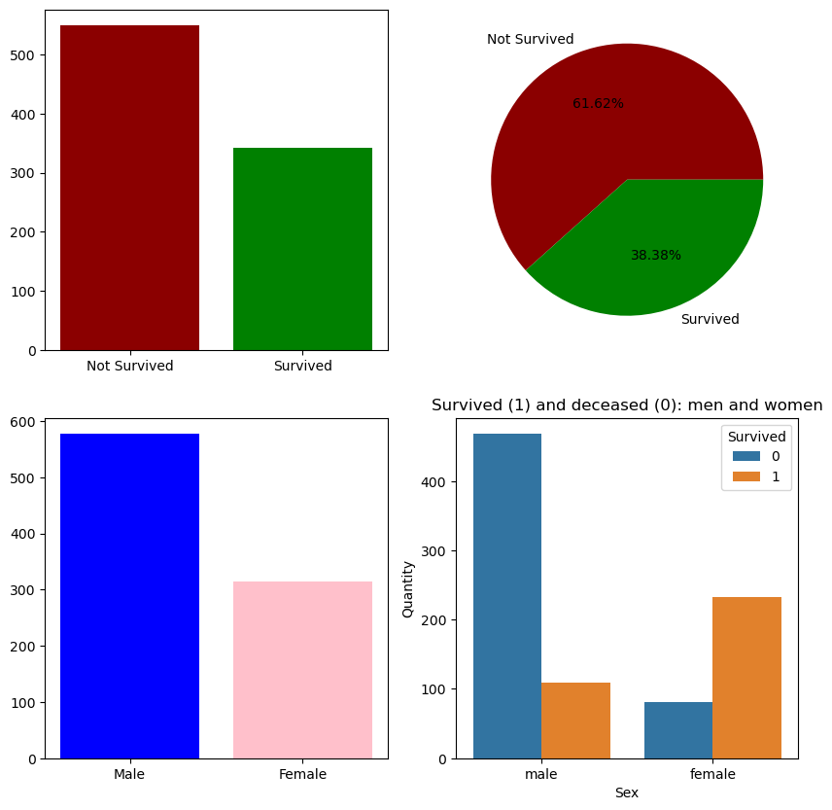
TITANIC SURVIVAL PREDICTION
Use the Titanic dataset to build a model that predicts whether a passenger on the Titanic survived or not.
Observations on dataset

Slide 4
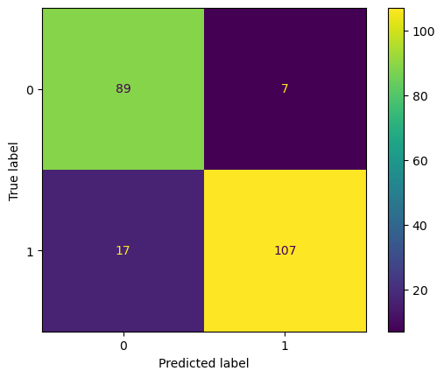
TITANIC SURVIVAL PREDICTION
Best Model Algorithm is Random Forest Classifier
Training Score: 90% Testing Score: 89%
Confusion Matrix of Test Data

Slide 5
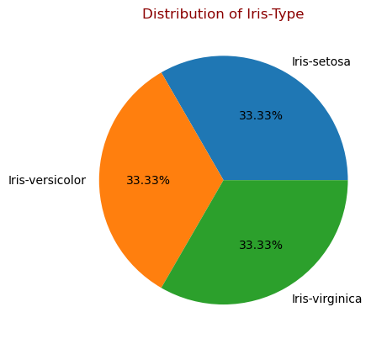
IRIS FLOWER CLASSIFICATION
Develop a model that can classify flowers into 3 different species
Observations made on IRIS dataset
150 samples
3 Species (Iris Classification)
Setosa
Versicolor
Virginica
Parameters/ Features:
Sepal Width
Sepal Length
Petal Width
Petal Length

Slide 6
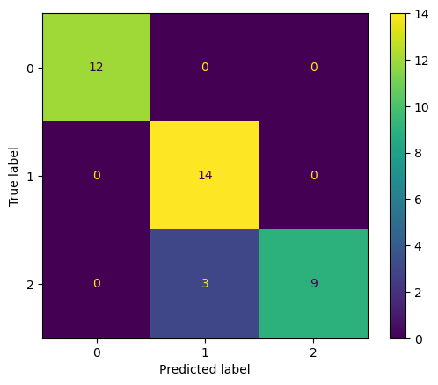
IRIS FLOWER CLASSIFICATION
Best Model Algorithm is Voting Classifier
Training Score: 98% Testing Score: 92%
Confusion Matrix of Test Data

Slide 7
SALES PREDICTION
Sales prediction involves forecasting the amount of a product that customers will purchase
Parameters are advertisements on TV, Radio and Newspaper
After analyzing and data interpretation, trained machine learning model
Gradient Boosting Regressor
Training Score: 99% Testing Score: 96%
Helped to make informed decisions regarding advertising costs.

Slide 8
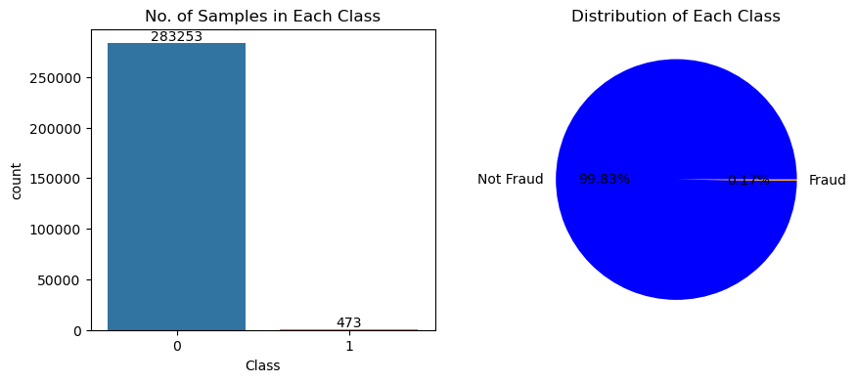
CREDIT CARD FRAUD DETECTION
A Model to identify fraudulent credit card transactions
Observations on dataset
Used Under-Sampling technique and then SMOTE to balance the dataset.

Slide 9
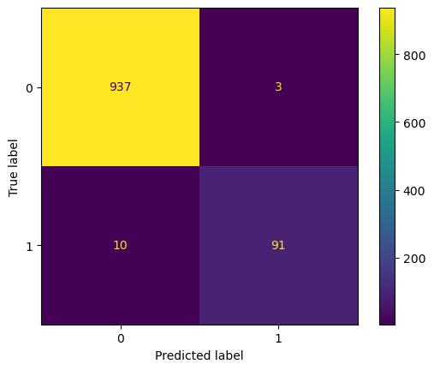
CREDIT CARD FRAUD DETECTION
Best Model Algorithm is XGBoost Classifier
Training Score: 100% Testing Score: 98.7%
Confusion Matrix of Test Data

Slide 10
MY EXPERIENCE AT CODSOFT
Completed 4 Project models using machine learning
Gained hands-on experience in:
Data preprocessing and cleaning
Feature engineering
Model development and evaluation
Result interpretation and visualization
Enhanced proficiency in Python and various machine learning algorithms.

Slide 11

THANK YOU

